Slide 1
Innovative test solution
Provider
- Probe pin Datasheet -

Slide 2
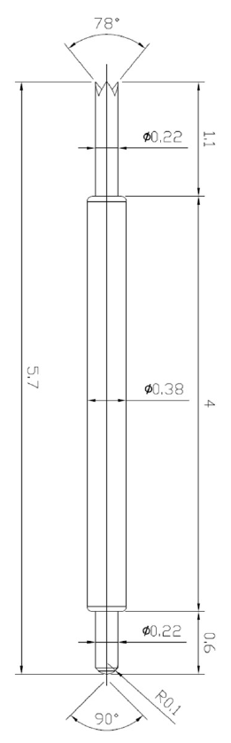
※ POGO type – 0.5 pitch high speed
IVB-DCR-570-038-A233-00
Pitch | 0.5mm
Total Length | 5.7mm
Use Length | 5.05mm
Use Stroke | 0.65mm
Max Stroke | 0.85mm
Spring Force at Use Stroke | 27gf at 0.65mm Stroke
Operating Temperature | -45 to 140°C
DC Resistance | 50.0mΩ at 0.65mm stroke
Current Rating | 1.6A
Self Inductance | 1.57 nH
Bandwidth @ -1dB | 16.7 GHz
Top Plunger | BeCu / Au over Ni
Bottom Plunger | BeCu / Au over Ni
Barrel | Phosphor bronze / Au over Ni
Spring | Stainless Steel / Au
Insertion Life | 100,000 cycles at 0.65mm Stroke

Slide 3
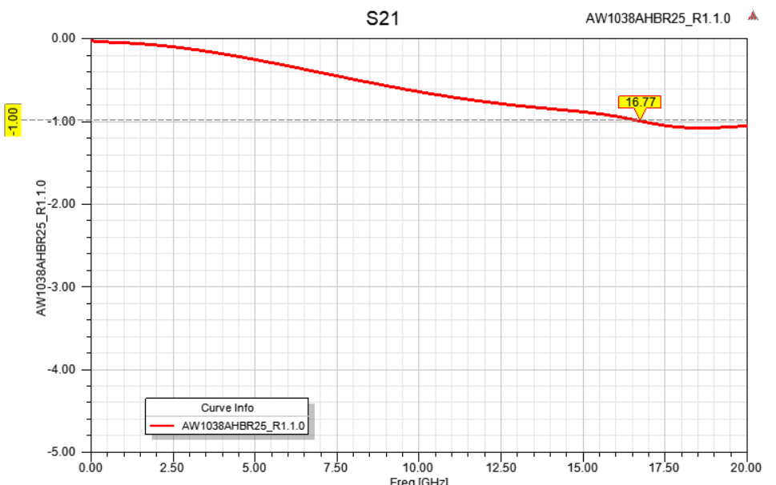
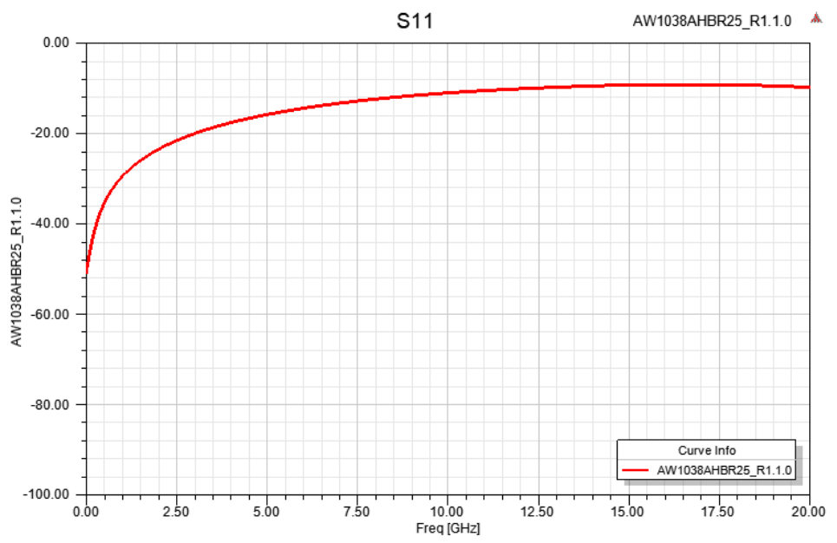
※ POGO type – 0.5 pitch high speed
Pin name | IVB-DCR-570-038-A233-00
Test code | AW1038AHBR25_R1.1.0
Pitch | 0.5
Test length | 5.05
Er | 4
Arrange | GSG
-1dB@ | 16.7

Slide 4
Thank you.

